Slide 1
Get Out of your Car and Ride Your Bike! Its Green, Healthy, and Good Economics
By
John Gilderbloom and
Students in Professor Gilderbloom’s Advance Graduate Research Methods Class
Spring 2010
Notes:
1

Slide 2
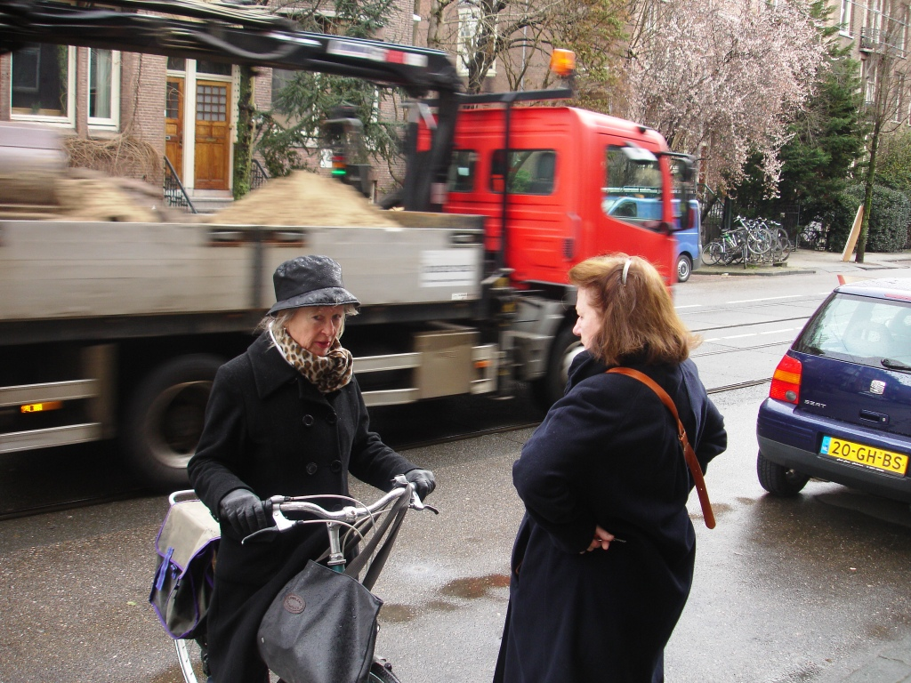
2
Notes:
2

Slide 3
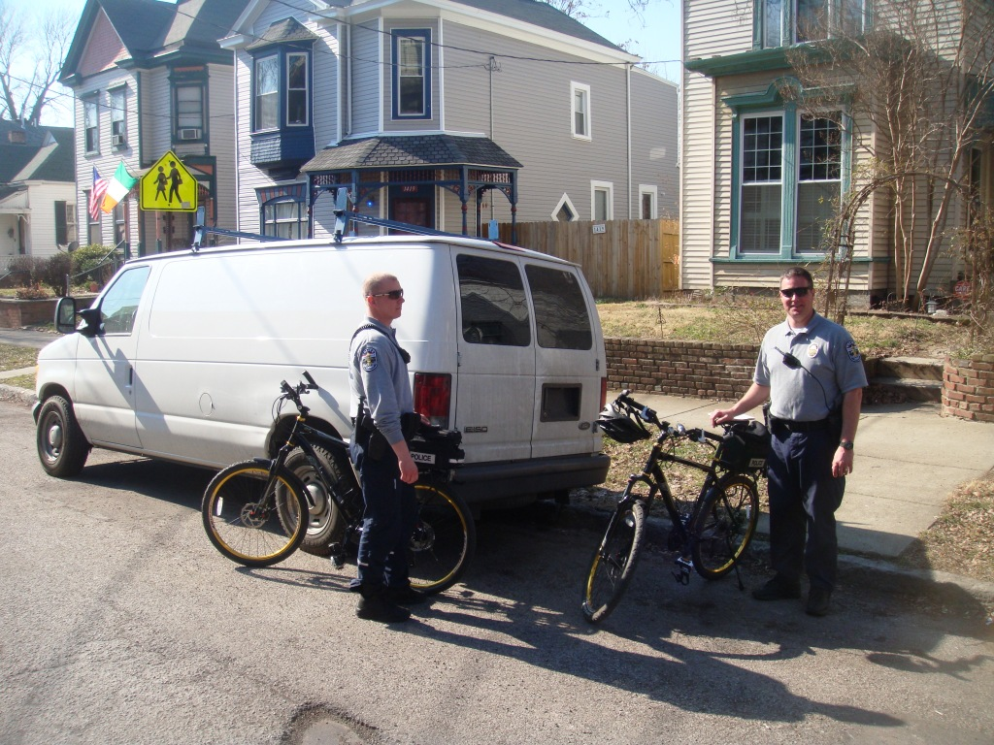
3
Notes:
3

Slide 4
Reasons for Everyone to Support Cycling
More daily physical activity and better personal health
Reduced medical costs for everyone, directly and indirectly
Improved traffic safety and more livable neighborhoods
Better Environment: Reduced air, water, and ground pollution; less noise; less disruption of natural ecosystems
Reduced Greenhouse Gases and global warming
Improved accessibility and increased social and economic integration of all groups
Reduced traffic congestion, parking needs, energy use

Slide 5
Health Benefits
Biking is Good Exercise!
  Both for daily travel and for recreation
  Cheaper, easier, and more dependable than formal exercise routines
  Can be integrated into daily lifestyle to achieve practical travel needs

Slide 6
People Don’t Ride Bikes Here Compared to Other Cities: Is it to Dangerous?

Slide 7
Bike use for daily commutes in other Industrialized Countries

Slide 8
Environmental Impacts
Mode of Transportation in Jefferson County
Transportation Mode | Number of Workers (>16yrs old)
Bicycle | 737
Walk | 6,556
Public Transit | 10,096
Car/Truck/Van | 302,309
-drive alone | 265,977
-car pool | 36,332
Total | 329,091
Notes:
U.S. Census 2000 SF3 data

Slide 9
Survey Results
9
What method do you most frequently use to get to and from campus?
Notes:
9

Slide 10
Health Deterrents
Cyclists are 12X more likely to be killed than drivers
Louisville ranked 7th most dangerous city for pedestrians
Louisville averages 165 accidents per year
Table 2. Bicycle - Automobile Collisions (2008)
Location | Accidents | Injuries | Fatalities
Kentucky | 489 | 353 | 6
Jefferson County | 162 | 116 | 3
Sources: http://www.kentuckystatepolice.org/pdf/KY_Traffic_Collision_Facts_2008.pdf; Gowin, Countywide Countermeasures 02
Notes:
In Pedaling Revolution, Jeff Mapes explains that roads should be “designed for the most vulnerable users, not the maximum number of cars,” (Mapes). Roads, for that reason, must be designed for cyclist safety because, according to Delmelle and Thill (2008), cyclists are twelve times more likely to be killed than motorists. The Transportation for America Dangerous by Design project revealed that Louisville was ranked the seventh most dangerous city for pedestrians, which is also an indicator of bicyclists’ safety as well (Transportation for America). According to the Kentucky State Police, there were 532 bicycle crashes in Jefferson County between January 1, 2006 and May 31, 2009, averaging about 165 accidents annually. Jefferson County had three bicycle fatalities in 2008 (Gowin, Countywide Countermeasures 02). That same year, the Kentucky State Police reported 489 total bike accidents that resulted in six fatalities and 353 injured cyclists for the entire state (KSP). Half of the state’s bicycle deaths for 2008, therefore, occurred in Jefferson County (see Table 2. Bicycle - Automobile Collisions (2008)). This could be partially attributed to Louisville holding the largest population in Kentucky (because there is a larger population, there may be more cyclists), but it still points to a greater problem of bicycle safety concentrated within Louisville. A breakdown of the 2008 state data reveals that 23.31% of bicycle injuries and half of deaths were due to inattention of the driver (KSP). For the same year, 13.91% of bicycle injuries were due to driver failure to yield to the right-of-way (KSP). In Jefferson County, the angle turn collision type accounted for the largest number of bicycle accidents, with 241 crashes between January 1, 2006 and May 31, 2009 (Gowin, Countywide Countermeasures 02). Angle turn collisions may be the result of right or left hand motorist turns and occur when a driver turns into the path of a cyclist upon a right or left hand turn, often from not seeing the cyclist approaching the driveway or intersection. During the same time period, sideswipe collisions, where the motorist and cyclist are in the same direction, are the second most common accident type in Jefferson County. Thirty-nine sideswipe collisions occurred between January 1, 2006 and May 31, 2009 (Gowin, Countywide Countermeasures 02). These data suggest that improving driver attention and right-of-way adherence could reduce injury and mortality risk, thus improving safety for cyclists. While it is true that use of protective equipment including helmets improves personal safety for individual cyclists, the built environment also contributes greatly to the above factors by influencing driving habits and bicycle safety for all cyclists. This is a public health concern because improving safety for cyclists prevents avoidable injury and death.
1/3 of the state lives in jeff co.
"We don't even like to own up to the full tool of automotive mayhem, which is the equivalent of two jumbo jetliners crashing every week and filling everyone on board." (Jeff Mapes, Pedaling Revolution, p208)

Slide 11
Health Deterrents
Source: Pucher and Dijkstra (2003)
11
Notes:
In addition to worse health outcomes in the US, Pucher and Dijkstra (2003) found that cycling in the US is more dangerous for cyclists than cycling in the Netherlands. Their data revealed that the US fatality rate per 100 million bike trips is 12.5 times higher than in the more bike-hospitable Netherlands. Additionally, the fatality rate per 100 million km traveled is also higher in the US than the Netherlands, with values of 7.2 and 2, respectively. A comparison of the injury rate per 500,000 km traveled reveals a considerable difference between the US and the Netherlands, 25 and 0.4, respectively (see Figure 2. Bicyclist Fatality and Injury Rates). Enhancing bike safety may reduce injuries and fatalities and allow for more access to physical activity to improve health outcomes.
Change colors (blue netherlands)
11

Slide 12
Biking is dangerous in the USA!
Five times more likely to die in a Bike Accident in the USA than Holland

Slide 13
Health Deterrents
Source: Gowin, Designing Streets for Bicyclists; Pucher and Dijkstra (2003)
Notes:
The speed of motor travel on streets greatly influences bicycle safety. The speed at which traffic travels is often an indication that roads are not designed for the most vulnerable users, but instead for the motorist. As Dan Burden, a bike advocate, explains, “The human body is not designed to move faster than fifteen miles per hour. Our sight, our ability to interpret things, to process things, is bicycling speed,” (Mapes). Burden, therefore, advocates travel all at a human speed, expressing that high speed traveling is unnatural. In addition to being unnatural, high speed travel poses additional safety risk for cyclists. Klop and Khattak (1999) found that increased speed limits were associated with increased severity of cyclist injuries in accidents. Similarly, a study by Kim et al. (2005), found that the likelihood of severe injuries increases as vehicular speed increases and the fatality risk for cyclists more than doubles when motorist speed is above thirty miles per hour. A talk led by Gowin revealed that if a cyclist is hit by a car traveling at twenty miles per hour, there is a five percent chance the accident will result in a cyclist fatality (Gowin, Designing Strees for Bicyclists). That chance, he explained, grows rapidly to forty-five percent when the automobile is traveling at thirty miles per hour, and even more significantly to eighty percent fatality at forty miles per hour (see Figure 3. Bicyclist Fatality Risk Associated with Motorist Speed in Collisions) (Gowin, Designing Strees for Bicyclists). This indicates a need to keep car speed limits below thirty miles per hour when bike presence is possible to reduce the mortality risk associated with traveling speed. Reducing speed limits is one way to reduce motorist speed, but it could draw great opposition from motorists, who would feel that their vehicle independence had been violated. Reduced speed limits may be both feasible and reasonable in urban centers and residential areas, but much less feasible on state highways. Inclusion of bike lanes or separated paths may help protect cyclists from high speed motorists in those areas, but should be carefully researched beforehand to ensure they would not increase unsafe exposure. Methods other than reducing speed limits including reducing the number of lanes of traffic and narrowing roads have been associated with decreasing speeds as well and may draw less resistance from motorists that oppose speed limit reductions (Pedestrian and Bicyclist Intersection Safety Indices Final Report). One key factor influencing traveling speed and bicycle safety is the street layout.

Slide 14
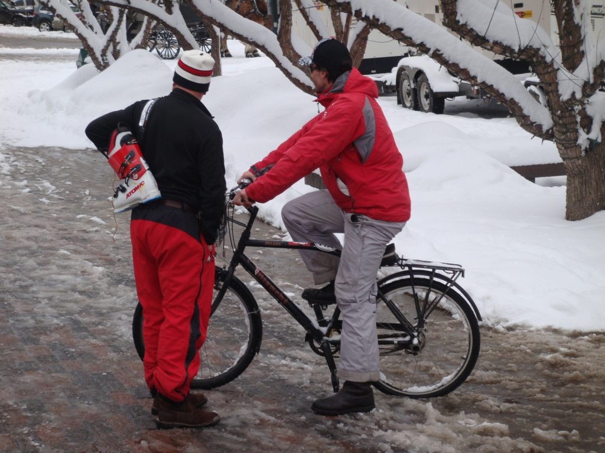

Slide 15
Climate
Source: www.bbc.co.uk/weather/world/city_guides
15
Louisville’s Sunshine for Cycling
Notes:
Louisville Sunshine for Cycling
15

Slide 16
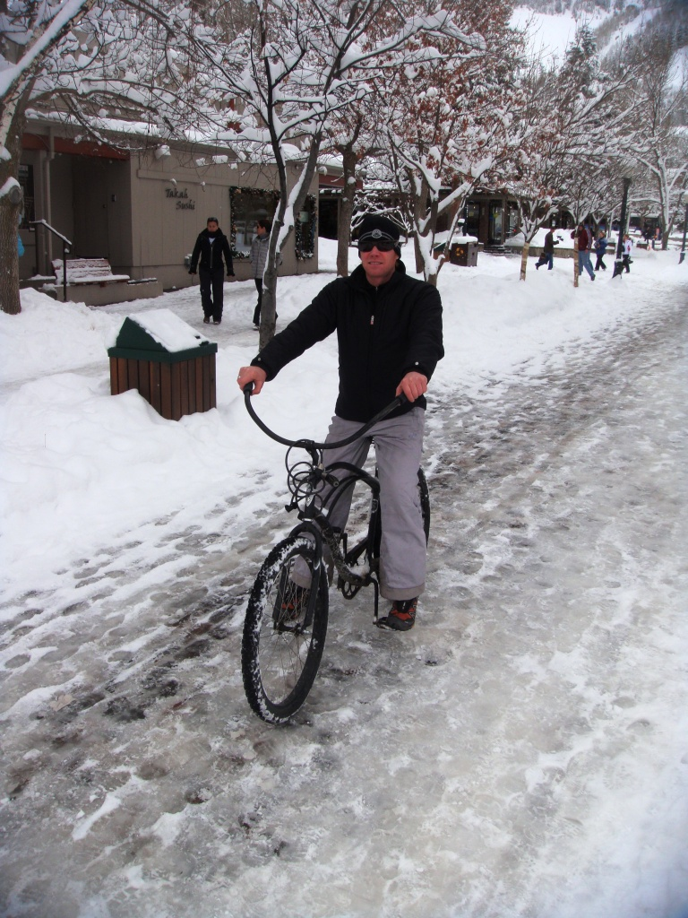

Slide 17
Climate
Source: www.bbc.co.uk/weather/world/city_guides
17
Average rainfall is similar to other bike cities!
Notes:
17

Slide 18
Climate
Source: www.bbc.co.uk/weather/world/city_guides
18
Louisville’s Temperature to other Bike Cities
Notes:
18

Slide 19
Health Benefits
Obviously, the daily physical exercise of walking and cycling for practical travel helps burn up calories and helps avoid the problems of overweight and obesity
Moreover:
“Whether normal-weight, overweight, or obese, physically inactive persons are 2 to 3 times more likely to die prematurely."
Journal of Am. Med. Assoc. (1999)

Slide 20
Health Benefits
Physical inactivity is the second leading cause of death

Slide 21
Health Benefits
Health Indicators Associated with Physical Inactivity
Health Indicator | Jefferson Co. | KY | US | KY Rank*
Moderate/ Vigorous Physical Activity Participation | N/A | 42%⁴ | 49%⁴ | 46⁴
Life Expectancy (years) | 75¹ | 76⁴ | 78⁴ | 43⁴
Heart Disease Mortality Rate (per 100,000 people) | 206.9² | 235.5⁴ | 200.2⁴ | 46⁴
Cancer Incidence Rate (per 100,000 people) | 577.6³ | 500.2⁴ | 458.2⁴ | 48⁴
Diabetes Prevalence | 10%² | 9.8%⁴ | 8.2%⁴ | 42⁴
Adult Obesity Prevalence | N/A | 67%⁴ | 63%⁴ | 46⁴
Child Obesity Prevalence | N/A | 37%⁴ | 32%⁴ | 48⁴
Asthma Prevalence | 11%² | 9.0%⁴ | 8.2%⁴ | 37⁴
Note 1. *KY rank in the US. Source: http://www.statehealthfacts.org/profilecat.jsp?rgn=19&cat=2. Sources: 1. http://www.communityhealth.hhs.gov/SummaryMeasuresOfHealth.aspx?GeogCD=21111&PeerStrat=3&state=Kentucky&county=Jefferson; 2. http://www.kentuckyhealthfacts.org/data/location/show.aspx?county=Jefferson; 3. http://cancer-rates.info/ky/index.php; 4. http://www.statehealthfacts.org/profilecat.jsp?rgn=19&cat=2
Notes:
life expectancy was 78.81 years in the Netherlands
the Netherlands diabetes prevalence in 2008 of 3.9%, which is less than half the Kentucky diabetes prevalence (StatLine). national prevalence, with values of 66.6% and 63%, respectively (Health Status - Kentucky). Also in 2007, Kentucky was 2005 obesity rates in the Netherlands, US obesity was slightly over 20% higher (Gilderbloom, Hanka and Lasley).
Health indicators influenced by physical activity leave Kentucky ranked among the highest in the nation for poor health. Providing more access to physical activity through increasing bikability (the measure of how conducive the built environment is for biking) may prove beneficial in reducing these health outcomes
Change Ranks!

Slide 22
Health Benefits
Stress Reduction
  47% of adults suffer adverse effects of stress³
  75-90% of primary care physician visits are stress-related²
  60% of work absences are due to stress⁷
    Costs companies $57 billion/year
  Stress is related to mortality from heart disease, cancer, depression, cirrhosis, lung disease, and suicide
  Physical activity reduces stress
Notes:
In addition to reducing risk chronic diseases and weight gain, regular physical activity also reduces stress levels (Fox). It is estimated that forty-seven percent of adults suffer from adverse effects of stress (APA Stress Survey: Children More Stressed than Parents Realize)and seventy-five to ninety percent of primary care physician visits are related to stress (America's No.1 Health Problem). Sixty percent of work absences are attributed to stress, which is estimated to cost companies over fifty-seven billion dollars yearly (Clark). Stress is related to mortality from heart disease, cancer, lung disease, accidents, depression, cirrhosis, and suicide. The many physical and mental health outcomes associated with stress provide a stronger argument for increasing access to physical activity because of its stress reducing qualities.

Slide 23
Health Benefits
Source: http://www.nutristrategy.com/fitness/cycling.htm
Notes:
NutriStrategy estimates that light cycling (10-11.9 miles per hour) could burn between 300-500 calories per hour, 500-700 calories per hour for moderate cycling (12-13.9 miles per hour), and vigorous cycling (14-15.9 miles per hour) could burn between 600 and 800 calories per hour (see Figure 1. Calories Burned During Bike Riding) (Calories Burned Bike Riding or Cycling). Marshall et al. 2009 reports that “reducing the average energy imbalance (caloric intake minus metabolic activity) among persons in the United States by approximately 100–165 kcal/day would prevent average weight gain” of about one kg/year (Marshall, Brauer and Frank).
Put it in english – 20% of your daily recommended calorie intake

Slide 24
Health Benefits

Slide 25
Survey Results
I would walk or bike for transportation in order to improve my health.

Slide 26
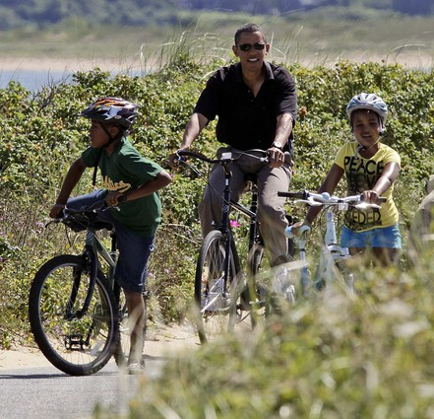
Health Impacts of Bicycling
The built environment influences environmental exposures
Roads should be designed for the most vulnerable users, not the maximum number of cars – Mapes¹⁸
Increased opportunities for biking in the built environment encourage physical activity
KY health indicators reveal a need for increased physical activity
http://latimes.image2.trb.com/lanews/media/photo/2009-08/48909182.jpg
Notes:
The interaction between people and built environment, therefore, impacts public health by influencing exposures to environmental factors that may reduce or contribute to injury or even death. According to the Tompkins County Planners of New York, the built environment is “the part of the environment formed and shaped by humans, including buildings, structures, landscaping, roads, signs, trails, and utilities,” (Tompkins County Planning). Community design in the built environment shapes opportunities to improve health through physical activity. In 2007, Kentucky was ranked forty-sixth for participation in moderate or vigorous physical activity (Health Status - Kentucky). For the same time period, it was estimated that 42.2% of Kentuckians engage in moderate or vigorous physical activity, compared to 49.2% nationally (see Table 1. Health Indicators Associated with Physical Inactivity) (Health Status - Kentucky). Increased opportunities for biking in the built environment encourage physical activity.
Physical activity decreases morbidity and mortality, cardiovascular disease risk, risk of certain cancers, diabetes risk, obesity risk, and asthma risk (Wendell, Tom and Rohm). In 2005, the life expectancy in Kentucky was 75.5 years and 78.0 years for the US, leaving Kentucky ranked forty-third in the nation for life expectancy (Health Status - Kentucky). During the same time period, life expectancy was 78.81 years in the Netherlands (Netherlands Life expectancy at Birth), known to be more bike and pedestrian friendly than the US (Gilderbloom, Hanka and Lasley): with reports of 40% non-motorized travel compared to 7% in the US (Pucher and Dijkstra). The Jefferson County life expectancy is predicted to be 75.3 years (Community Health Status Indicators). Life expectancy estimates for 2009 show the Netherlands ranked thirtieth in the world at 79.4 years, while the US is ranked forth-ninth with 78.11 years (The World Factbook). In 2006, Kentucky was ranked sixth highest in the nation for heart disease mortality with a rate of 235.5 per 100,000 people, compared to the national heart disease mortality rate of 200.2 per 100,000 people (Health Status - Kentucky). Heart disease mortality for Jefferson County is estimated to be 206.9 per 100,000 people (Kentucky Health Facts). Cancer incidence was the fourth highest in the nation in 2004 (Health Status - Kentucky). The 2004 cancer incidence for Kentucky was 500.2 per 100,000 people, while the US incidence was 458.2 per 100,000 (Health Status - Kentucky). The Jefferson County cancer incidence for 2004 was 577.63 per 100,000 people (Kentucky Cancer Registry). The 2008 diabetes prevalence in Kentucky is 9.8%, compared to the US prevalence of 8.2% (Health Status - Kentucky). Kentucky was ranked ninth highest for diabetes prevalence in the US in 2008 (Health Status - Kentucky). The diabetes prevalence is even higher for Jefferson County with 10% of the population estimated to be diabetic (Kentucky Health Facts). More bike- and pedestrian-friendly countries, like the Netherlands displayed diabetes prevalence in 2008 of 3.9%, which is less than half the Kentucky diabetes prevalence (StatLine). The 2007 Kentucky was ranked sixth highest for adult obesity (body mass index of thirty or greater) in the US (Health Status - Kentucky). Kentucky obesity prevalence is just above the national prevalence, with values of 66.6% and 63%, respectively (Health Status - Kentucky). Also in 2007, Kentucky was ranked third highest for childhood obesity with a Kentucky prevalence of 37%, compared to the US prevalence of 32% (Health Status - Kentucky). In comparison with 2005 obesity rates in the Netherlands, US obesity was slightly over 20% higher (Gilderbloom, Hanka and Lasley). In 2007, Kentucky had the fourteenth highest asthma prevalence 9.0%, compared to 8.2% for the nation (Health Status - Kentucky). In Louisville, the asthma prevalence is even higher at 11% (Kentucky Health Facts). In summary, health indicators influenced by physical activity leave Kentucky ranked among the highest in the nation for poor health. Providing more access to physical activity through increasing bikability (the measure of how conducive the built environment is for biking) may prove beneficial in reducing these health outcomes.

Slide 27
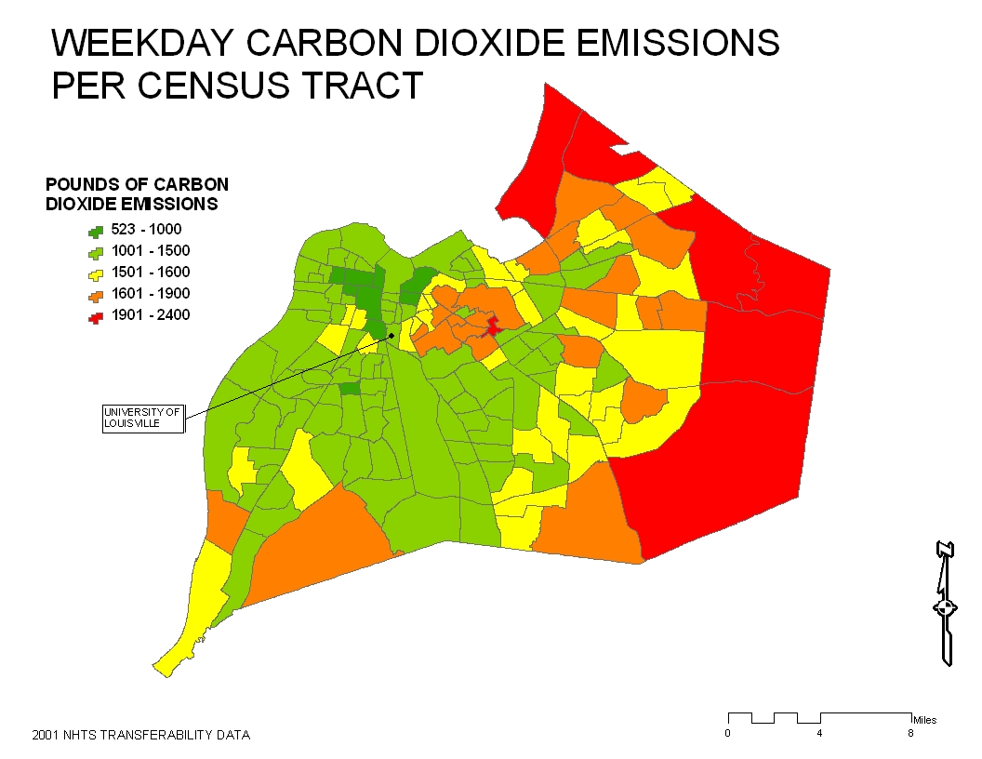
Environmental Impacts
Notes:
Carbon dioxide emissions calculated from vehicle miles traveled. Data acquired from the National Household Transportation Survey 2001 – a U.S. Department of transportation effort sponsored by the Bureau of Transportation Statistics and Federal Highway Administration.
Based on an average fuel efficiency of 22.5 mpg (Bureau of Transportation Statistics: 2007 passenger car@ http://www.bts.gov/publications/national_transportation_statistics/html/table_04_23.html)
Inspired by: The Greenness of Cities: Carbon Dioxide Emissions and Urban Development, Edward Glaeser and Matthew Kahn. Harvard University Rappaport Institute/Taubman Center Policy Brief. National Bureau of Economic Research, Inc.

Slide 28
Environmental Impacts
US greenhouse gas emissions
  Carbon dioxide accounts for 80% of GHG emissions in US
  A third of that total is transportation related
  ½ of all car trips are less than 5 miles (Maibach et al. 2009)
Other
Transportation
Carbon Dioxide (80%)
Notes:
Federal Highway Administration 2009
Third bullet: Maibach, E., L. Steg, J. Anable. 2009. Promoting physical activity and reducing climate change: Opportunities to replace short car trips with active transportation. Preventitive Medicine, 49, 326-327.

Slide 29
Health Deterrents
Traffic-Related Air Pollutant | Vehicular Contribution | Traffic Emission Type | Health Effects
Carbon monoxide (CO) | 77% | Primary Pollutant | Mortality in enclosed areas
Oxides of nitrogen (NOx) | 56% | Primary Pollutant | Airway irritation
Oxides of sulfur (SOx) | 7% | Primary Pollutant | Airway irritation
Ozone (O₃) | N/A | Secondary Pollutant | Airway irritation; asthma; impaired lung development in children; short- and long-term respiratory damage
Particulate matter (PM) | 25% (PM₁₀) | Primary, Secondary Pollutant | Asthma; cancer mortality; lung cancer (PM2.5); cardiopulmonary mortality; cardiovascular disease mortality (PM_{2.5}); impaired lung development in children; pulmonary disease mortality; reduced life expectancy; respiratory irritation; respiratory disease mortality
Source: Frumkin Frank and Jackson 2004
29
Notes:
Exposure to pollution from traffic exhaust is associated with asthma and asthma exacerbations, decreased lung function, cardiopulmonary mortality, and atherosclerosis (Marshall, Brauer and Frank). Motor vehicles are point source polluters of carbon monoxide (CO), carbon dioxide(CO₂), oxides of sulfur (SOx), and oxides of nitrogen (NOx) (Frumkin, Frank and Jackson). CO is linked with mortality (Frumkin, Frank and Jackson). NOx and SOx have been associated with airway irritation (Frumkin, Frank and Jackson). Ozone (O₃) is a regional pollutant that forms when oxides of nitrogen and volatile organic chemicals react in the presence of sunlight (Frumkin, Frank and Jackson). O₃ has been associated with airway irritations and asthma exacerbation (Frumkin, Frank and Jackson). Additionally, particulate matter (PM) pollution is associated with vehicular traffic as well, resulting from combustion. PM is associated with cardiovascular disease, pulmonary disease, and cancer mortality (see Table 3. Health Effects Resulting from Air Pollution Exposure) (Frumkin, Frank and Jackson). Marshall et al. (2009) found that pedestrian friendly neighborhoods often had higher nitric oxide levels than neighborhoods that were less pedestrian friendly (Marshall, Brauer and Frank). This indicates that increasing bikability may increase the amounts of people exposed to traffic exhaust pollution.
29

Slide 30
Environmental Impacts
S.O.V. Drivers’ Interest in Biking to Campus on Dedicated Bike Lanes
Commute time to campus | Agree or Strongly Agree, % | Total commute, # | Agree or Strongly Agree , # | (SOV) % | Reduced SOV driven to campus, # | VMT, round trip, mi. | Reduced VMT by SOV, daily
10 min./less | 75 | 5500 | 4125 | 18 | 742 | 2 | 1484
11-20 min. | 66 | 8900 | 5874 | 31 | 1820 | 6 | 10920
21-30 min. | 54 | 8100 | 4374 | 32 | 1400 | 10 | 14000
31-40 min. | 46 | 3300 | 1518 | 13 | 197 | 20 | 3940
41-60 min. | 48 | 1600 | 768 | 6 | 46 | 30 | 1380
60 plus min. | 53 | 375 | 199 | 1 | 20 | 40 | 800
TOTAL |  |  | 16,858 |  | 4,225 |  | 32,524
Source: U.L. PLAN680 Bike Survey, 2010

Slide 31
Environmental Impacts
SCENARIO: Carbon Equivalent Reduction (CO₂e) from S.O.V. reduced commutes to campus
32,524 = VMT reduction per day (S.O.V. trips)
Tons CO₂* = ((mpg (x) VMT (x) CO₂ per gal. gas (x) other GHG CO₂ equivalent ))/1,000 (to convert kg to metric tons)
Tons CO₂ = (22.5 * 32,524 * 8.8 * (100/95)) / 1,000 = 6,778.5 metric tons CO₂e per day reduction
Full Time Equivalent Days = 8 months * 4 weeks * five days * .80 (to account for part time faculty/staff/students)
= 128 DAYS (FTE) Commutes
6,778.5 CO₂e reduction (x) 128 days of commutes = 867,648 metric tons CO₂e reduction per year
References:
2005 CAFÉ Fuel Economy level = 22.5 mpg http://www.nhtsa.gov/cars/rules/cafe
Other GHG CO₂ equivalent = 100/95 http://www.epa.gov/OMS/climate/420f05004.htm
CO₂ burned per one gallon of gasoline = 8.8 kg TIGGER federal register guidance or, http://edocket.access.gpo.gov/2009/pdf/E9-9469.pdf
*Model based on Tiger Grant application for Ames, Iowa: www.cyride.com

Slide 32
Environmental Impacts
Vehicle Miles Traveled (VMT)
  Reducing VMT provides almost a 1:1 reduction in CO₂ emissions
  Active transportation is a viable alternative to driving
    ∴ reduce congestion, oil dependence, air pollution, and greenhouse gas emissions
Notes:
Entire slide: Ewing et al. 2008 – Ewing, R., K. Bartholomew, S. Winkleman, J. Walters, and G. Anderson. 2008. Urban development and climate change. Journal of Urbanism, 1(3), 201-216.

Slide 33
Health Benefits
33
Burn Calories, Not Carbon!
  Shifting short trips to bicycling or walking could amount to a reduction of 2.4 billion to 5 billion gallons of fuel (21-45 million tons of CO₂ per year)
  A bicycle commuter who rides 5 miles to work, four days a week, avoids 2,000 miles of driving per year (100 gallons of fuel saved and 2,000lbs of CO₂ emissions avoided)
Notes:
33
(Gotschi and Mills 2008) – Gotschi, T. and K. Mills. 2008. Active Transportation for America. The Case for Increased Federal Investment in Bicycling and Walking. Rails to Trails Conservancy.
Burn Calories, Not Carbon! Trademarked by the Rails to Trails Conservancy

Slide 34
Our Survey of 2,000 plus Persons in Louisville

Slide 35
Survey Results
How much are you willing to pay for a gallon of gas before you consider alternative transportation?
Choice of transportation mode MORE flexible than choice of where to live.

Slide 36
Survey Results
Willingness to Move Closer to Campus
Choice of where to live LESS flexible than choice of transportation mode.

Slide 37
Survey Results
If the University provided more affordable student housing options within walking distance of campus by constructing more on-campus residence halls or entering into partnerships with private developers adjacent to campus, would you be interested?

Slide 38
Survey Results
Housing Interests, within Walking Distance of Campus
Commute time | Students Probably or Definitely Interested, % | Total Student commuters, # | Commute by car alone, % | Students Commute by car alone, Probably or Definitely Interested, #
10 min./less | 67 | 4352 | 18 | 783
11-20 min. | 50 | 6963 | 31 | 2158
21-30 min. | 45 | 6310 | 32 | 2019
31-40 min. | 61 | 2611 | 13 | 339
41-60 min. | 44 | 1088 | 6 | 65
60 plus min. | 80 | 217 | 1 | 2
TOTAL |  |  |  | 5,366

Slide 39
If they build it, they will bike!
If they build it, they will bike!
If a dedicated bike lane was provided from the respondents’ neighborhood to campus, he or she would be more likely to bike to campus.

Slide 40
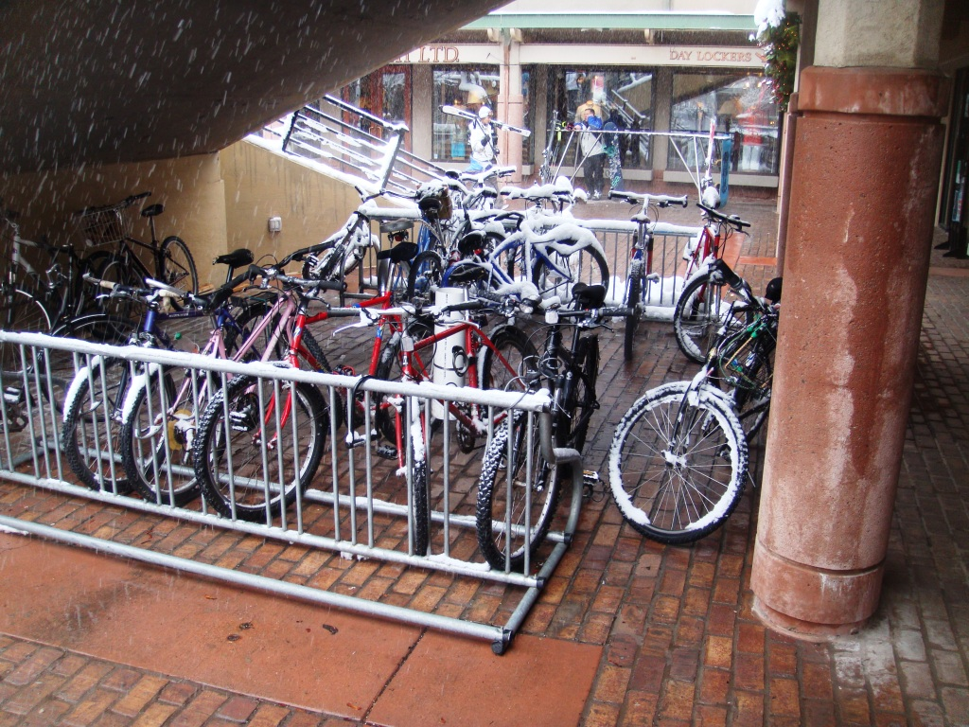
40
Notes:
40

Slide 41
Survey Results
What would make you more likely to bicycle to campus more often?

Slide 42
Survey Results
Of the following options, which do you think would be best for the University to provide?

Slide 43
Economic Benefits of Biking
Most American families spend more on driving than on health care, education or food.
  And the poorest families spend the most, sometimes more than 1/3 of their income goes to transportation.
The average American household devotes $0.18 of every dollar it spends to getting around
  In some metro areas, households are spending more on transportation than on shelter.
  The vast majority of that spending, 98%, is for the purchase, operation, and maintenance of automobiles.

Slide 44
Economic Benefits of Biking
Households in automobile-dependent communities devote 50 percent more to transportation (more than $8,500 annually) than households in communities with more accessible land use and more multi-modal transportation systems (less than $5,500 annually)
The City of Seattle estimates an average family trimming one vehicle from your household, saves them $340 per month
The estimated cost to build a parking spot in a garage is $20,000 to $23,000. The cost to purchase and install one bike parking rack is $1,503

Slide 45
New York City's Green Dividend, a report by CEOs for Cities that, for the first time, aggregates the economic value of walking, biking and transit to the New York City economy.
In time for Earth Day, the New York City Department of Transportation released New Yorkers would spend $19 billion more per year on auto-related expenses if, on average, they drove as much and owned as many cars as residents of other large U.S. cities. They would own a staggering 4.5 million additional cars (requiring a parking lot the size of Manhattan to hold them!), consume 2.4 billion more gallons of gas and produce 23 million more tons of carbon emissions every year.

Slide 46
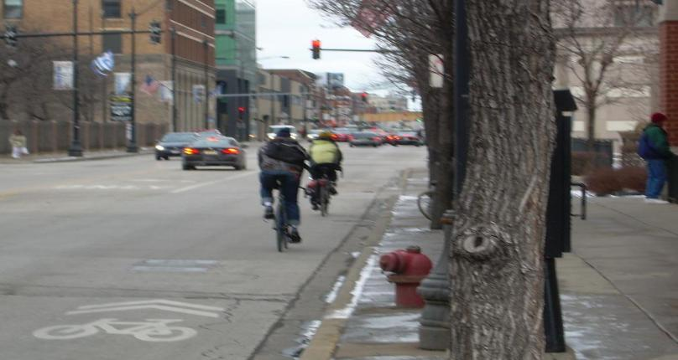
Economic Benefits of Biking
A 1999 study by the ULI, pedestrian-friendly communities determined that homebuyers were willing to pay a $20,000 premium for homes in them compared to similar houses in surrounding areas
In New Urbanist neighborhoods outside of Washington D.C. Tu and Eppli found the price premium of homes to be 14.9 percent, 4.1 percent in Laguna West near Sacramento, CA, and 10.3 percent in Southern Village in Chapel Hill, NC

Slide 47
Build Bike Racks not Parking Spaces
Scenario: University Savings from Reduced Parking Demand
  4,225 = Reduced # S.O.V to campus daily.
  $23,000.00 = University cost per new parking space
  LDC estimate* (business schools) :
    One parking spot per three employees.
    One spot per every four seats in classrooms.
  Just estimating employees (one-sixth) = 4,225 /6 = 704 cars.
    One parking spot per 3 employees = 234 reduced parking spots
    $ 26,000.00 (x) 234 parking spots = $6,084,000.00, just for employees.
    3,521 remaining cut in cars to campus would create additional savings, plus, leave more room for plazas and café tables and happy people!
*Land Development Code (LDC) calls for parking study to determine parking spaces for university campuses and for review by Planning Director.

Slide 48
Economic Benefits
Study of 170 Louisville Metro Neighborhoods:
  Using multiple regression analysis we have already published research on contemporary housing values shows the following:
  Historic Preservation District increases Housing values
  Living inside Watterson Expressway increases property values
  New Urbanist Neighborhoods show positive increases in value

Slide 49
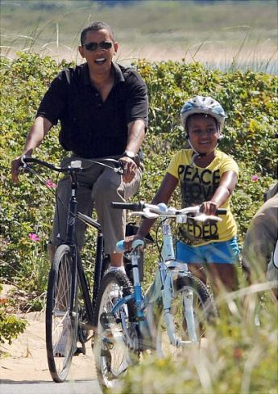
Economic Savings
 | Survey Population | Actual Population | Sample Size | Live close to campus | Actual population living close to campus
Faculty/Staff | 1,508 | 6,174 | 24.4% | 18.4% | 1,136
Student | 524 | 21,016 | 2.5% | 38.0% | 7,986
 | Percent interested in biking with a dedicated bike lane | Population interested
Faculty/Staff | 79.5% | 903
Student | 83.9% | 6,700
Total |  | 7,603

Slide 50
Economic Benefits of Biking
Scenario: S.O.V. Student commuters interested in walking-distance university housing
  Annual cost to own/maintain car = $8,000.00 (AAA Kentucky estimates)
  7,603 cars (x) $8,000 = $60,824,000, Total Annual Savings
Source: U.L. PLAN680 Bike Survey, 2010

Slide 51
Economic Savings
51
Notes:
51

Slide 52
If they Don’t Spend it on Cars, what would they do with the money?
Economists have estimated that non-car commuters from home to campus can save thousands of dollars a year--roughly $3,000 to $8,000 a year. If such savings were to be realized, what would you do with this savings? (The 2,032 respondents were allowed to give more than one answer)
10 of the 14 are LOCAL!

Slide 53
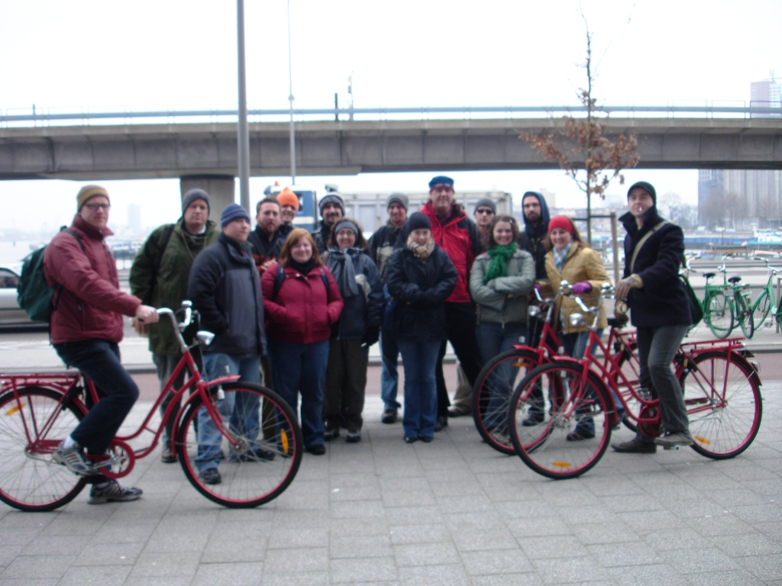
Biking: The Perfect Zero Emission Vehicle
Almost everyone has the potential to cycle
Many local trips in European and American cities are short enough to cover by bike
Crucial to design cycling policies and programs for everyone!
Must cater to huge range of cycling preferences and meet the diverse needs of different groups
Must be inclusive in cycling policies and programs to encourage widespread cycling and thus generate widespread public and political support

Slide 54
Social Aspects
Bike lanes also mean more elderly on bikes as well as women

Slide 55
Social Aspects
Only one out of every four bikers in the USA are women in the Netherlands it is Equal

Slide 56
Social Aspects
The Motorist? The Cyclist?
Typical Americans believe that cyclists are inferior to motorists in legal status and in competence, that cyclists should defer to motor traffic, and that failure to defer to motor traffic is dangerous. – John Forester, “Cyclists Choice of Ally”
  Regardless of what a “typical” American believes, both parties can be at fault on the road.

Slide 57
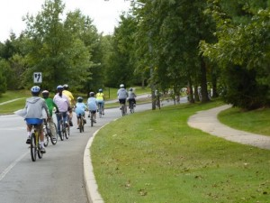
Social Aspects
Percentage of women cyclists indicates of bikeability.
Women will bike if they feel safe.
  Therefore safe biking infrastructure and education make cycling more mainstream.
Notes:
Women will bike if they feel it is safe. This is why a safe biking infrastructure and cycling education can play such a crucial role in making cycling a more mainstream mode of transportation.

Slide 58
Social Aspects
Women and Biking
  US men’s cycling trips out number women’s by at least 2:1 but WHY?
  Image – many women do not want to arrive at their destination (particularly work) sweaty and disheveled from a bike ride
  Weather – women may be less likely to ride in inclement weather
  Practicality– often, women are the “head of household duties” it is hard to use biking as a mode of transportation when you have to shop for groceries and shuttle the children across town
  While these are important aspects, research is showing us that the # 1 reason more women are not taking to the road as cyclists is…
Source: Baker, Linda “How to Get More Bicycles on the Road”
Notes:
In the U.S., men’s cycling trips out number women’s by at least 2:1* but WHY?
Image – many women do not want to arrive at their destination (particularly work) sweaty and disheveled from a bike ride
Weather – women may be less likely to ride in inclement weather
Practicality– often, women are the “head of household duties” it is hard to use biking as a mode of transportation when you have to shop for groceries and shuttle the children across town
While these are important aspects, research is showing us that the # 1 reason more women are not taking to the road as cyclists is…

Slide 59
Social Aspects
Bicycling is good for the soul!
People are more accessible to others on bicycles than behind the windshield of a car
People are more apt to talk to you, ask for directions, comment on your choice to ride a bike (hopefully in a good way!)
Biking can help build community amongs who share their same views.

Slide 60
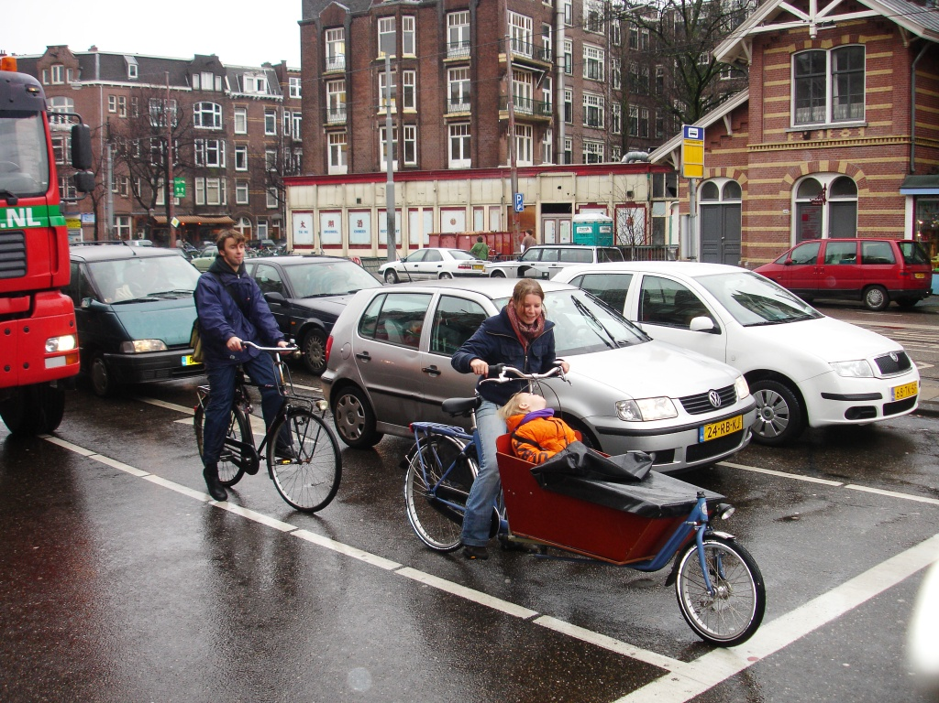

Slide 61
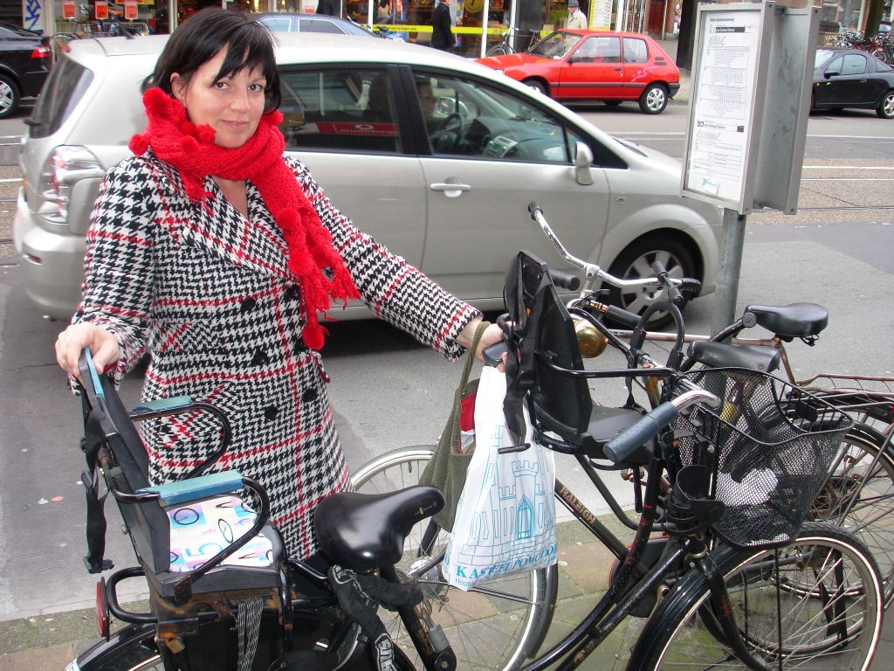

Slide 62
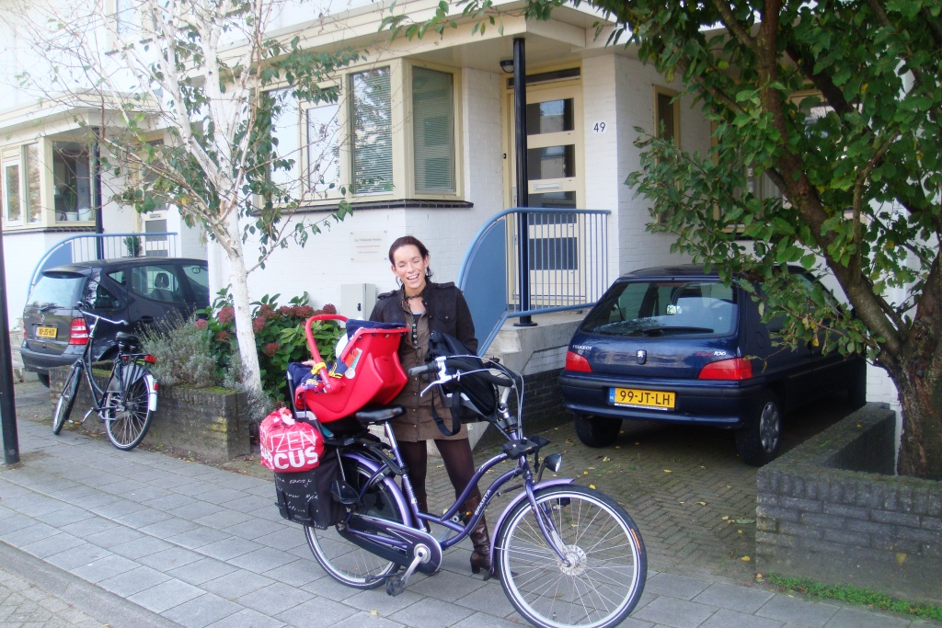

Slide 63
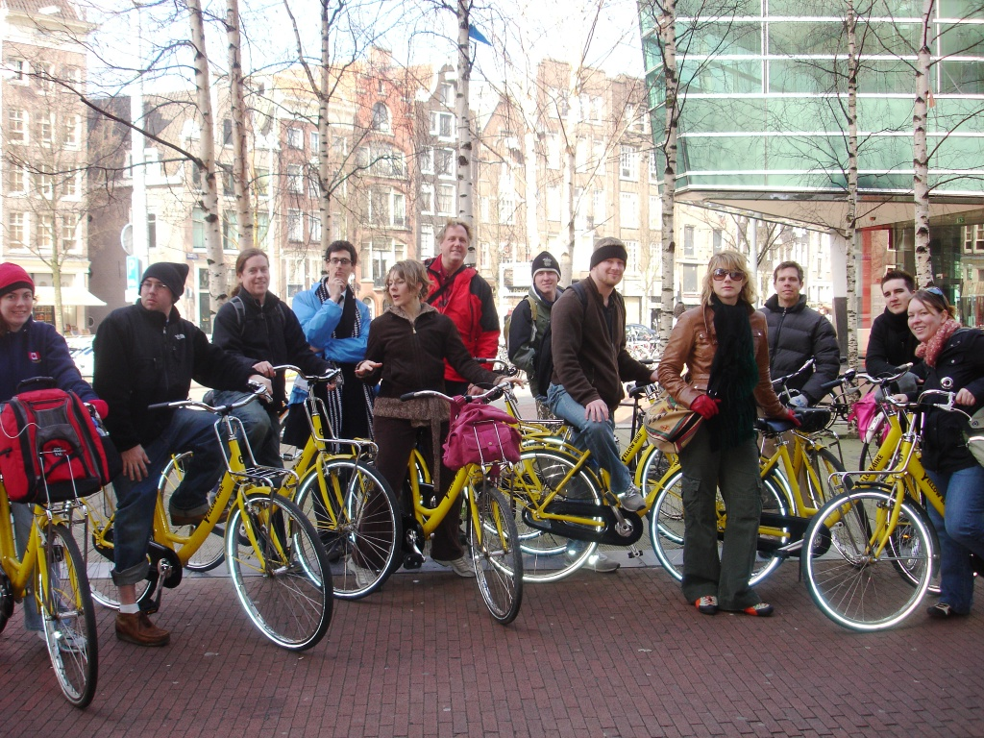

Slide 64
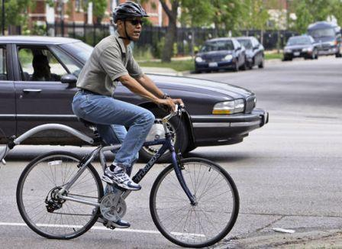

Slide 65
Bike Commuting by Household Income Group (2008-2012, ACS).
Household Income | % of workers | Margin of Error
$0 - $9,999 | 1.5% | 0.1
$10,000 - $14,999 | 1.1% | 0.1
$15,000 - $24,999 | 1.0% | Z
$25,000 - $34,999 | 0.7% | Z
$35,000 - $49,999 | 0.6% | Z
$50,000 - $74,999 | 0.5% | Z
$75,000 - $99,999 | 0.4% | Z
$100,000 - $149,999 | 0.4% | Z
$150,000 - $199,999 | 0.5% | Z
$200,000 + | 0.5% | Z
McKenzie, B. (2014, May). Modes Less Traveled: Bicycling and Walking to Work in the United States 2008-2012. Z = rounds to 0

Slide 66
Total Costs (per year and per mile) of Car Ownership and Operation for Medium and Large Sedans (AAA, 2013).
Total Cost Per Mile (15,000 miles/year) | Medium Sedan | Large Sedan
Cost per mile x 15,000 miles | $3,164 | $3,522
Cost per day x 365 days | $5,987 | $7,726
TOTAL Cost per year | $9,151 | $11,248
TOTAL Cost per mile | $0.61 | $0.75
American Automobile Association (AAA). (2013). 2013: Your Driving Costs.

