Slide 1
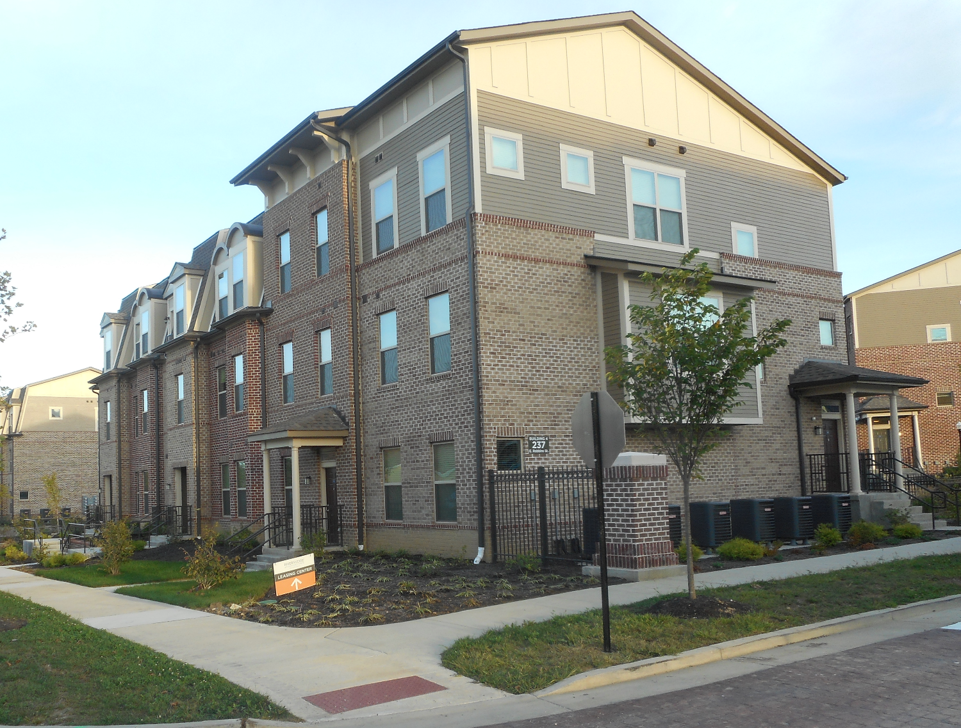
From Blighted to Beautiful:
Covington Hope VI Year Five Final Report
Dr. John Gilderbloom
Dr. James Canfield
Erin Hargrove
Presentation by Ra´Desha Williams
Prepared for Housing Authority of Covington
U.S. Housing and Urban Development

Slide 2
Introduction
Jacob Price
Virtually every major mechanical, electrical and plumbing system at Jacob Price Homes is either original to the 1939 construction or has exceeded its useful life expectancy. Like the units already demolished or taken out of service, the 70 currently occupied units suffer from deteriorated systems, design deficiencies, inaccessibility and density far exceeding any modern standard for urban living. The extent and nature of infrastructure and project site deficiencies, and fundamental design flaws preclude these facilities from rehabilitation. The structures contain inefficient mechanical systems that do not provide air conditioning or adequate envelope insulation; and unit interiors that are inadequate to meet the needs of today’s families, with undersized rooms, grossly inadequate closet space and no washer/dryer hook-ups; and the site’s outdoor spaces are dehumanizing, lacking any semi- private or private spaces (Covington’s HOPE VI Application, 2009).
The location is ideal for a HOPE VI program due to its close proximity to public transportation and parks, and it is within walking distance to jobs, stores and child care centers.

Slide 3
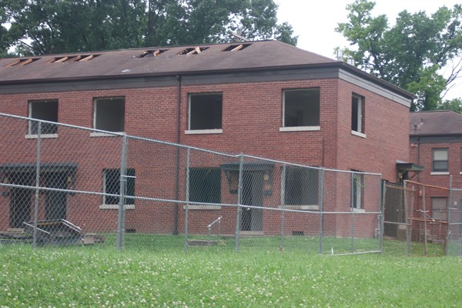
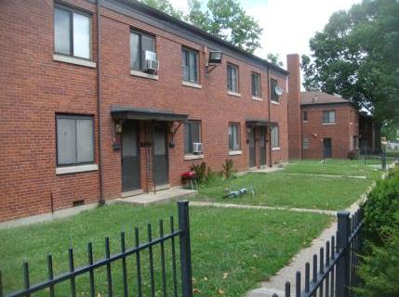
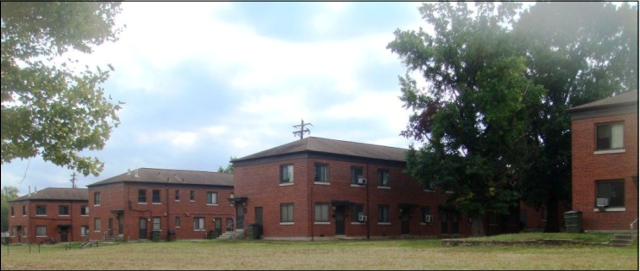

Slide 4
Jacob Price
The redevelopment of Jacob Price Homes through the HOPE VI Program provides Jacob Price residents, the City of Covington, and the Housing Authority with an unique opportunity to reclaim and revitalize the Jacob Price Site. Create a new mixed income community, catalyze the redevelopment of the surrounding neighborhood and provide employment and education opportunities to Jacob Price residents (HOPE VI Jacob Price Application, 2009).

Slide 5
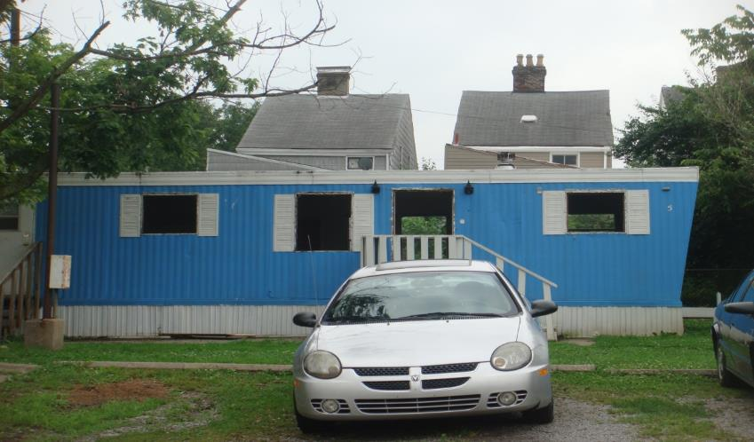
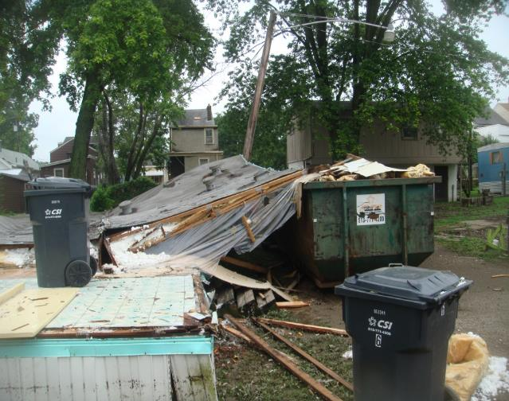
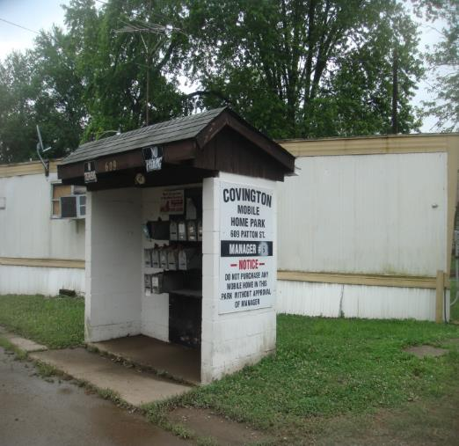

Slide 6
Affordable housing is seen as the key to sustainable neighborhoods.
Change the stigmatization of barracks-style housing with new urbanist design
Reduce the concentration of poverty
HOPE VI’s Four Important Objectives
Provide support services, jobs, education, and health services to residents
Develop partnerships between public and private agencies and organizations

Slide 7
Jacob Price Redevelopment
Blighted, barracks-style development into a model for public-private partnerships
Model of green development to reduce energy costs in the home
Locate development in a walkable neighborhood
10-walking distance
Necessary for the Eastside to climb out of a physically distressed environment
Catalyze the redevelopment of the surrounding neighborhood
Provide employment and education opportunities to Jacob Price residents

Slide 8
Executive Summary

Slide 9
Introduction
Builds upon previous reports
Final evaluation of the program
Prescribe where corrections need to be made
Correction of errors made in Year Four Report
GIS maps

Slide 10
Current Program Status
Development for River’s Edge at Eastside Pointe is near completion
50 out of 120 apartments units occupied as of mid-October 2015
Evaluation of the new development’s effects on the residents in the neighborhood is completed

Slide 11
$16 million was invested to construct 120 units costing roughly $133,000 each
Average house cost for building 149 single family and multifamily housing units was $147,000 each, using $19 million in federal funds

Slide 12
Cost of acquiring the sites, site prep, building landscaping, adding a basement, driveway parking, and meeting LEED requirements for nine single family units was $3 million, or $333,333 for each single family house built
Nine single family homes are subsidized to sell for $139,000 each

Slide 13
Evaluation
Addresses how physical environment shapes health, and therefore residents’ quality of life
Best practices for creating sustainable neighborhoods
Many were not addressed by programs such as LEED
Shows that most of the goals of HOPE VI have been met
Survey of 140 residents indicates HOPE VI and traditional public housing tenants are happier with their new housing

Slide 14
Research Methods
Quantitative and qualitative analysis
instruments:
Surveys
Interviews
2010 Census Data
Secondary data from the City of Covington
Photography
GIS mapping
Comparative Analysis
River’s Edge at Eastside Pointe vs. City Heights
Mixed-Approach

Slide 15
Principal Findings
Business Creation
Increase in Property Values
Static Trends in Crime Overall
HOPE VI residents are more satisfied with location, quality, and access to jobs and education than traditional public housing residents
High quality staff provides effective social service offerings
A reduction in residents’ energy bill and transportation costs at River’s Edge at Eastside Pointe

Slide 16
LEED Design
Reduces energy costs
Development called for R-38; however, developer used R-55
Hardy board and brick were used instead of plastic siding

Slide 17
Concerns
Smoking
Developer’s refusal to follow HUD Federal and Local smoke-free housing mandates
New regulations require over one million public housing units to be smoke-free
Scientific evidence suggests smoke-free housing will raise projected years of life for low income residents
Young millennials and middle class will choose smoke-free properties instead of River’s Edge at Eastside Pointe
Hope of mixed-income housing and viability of River’s Edge at Eastside Pointe will be threatened
Can prevent the development from becoming LEED certified
Bike Racks
Developers broke the promise to install bike racks

Slide 18
Recommendations
Pass ordinance prohibiting smoke in HOPE VI development in Covington
Replant the original urban “veggie” garden in the northeast area

Slide 19
Overview of Community Impact

Slide 20
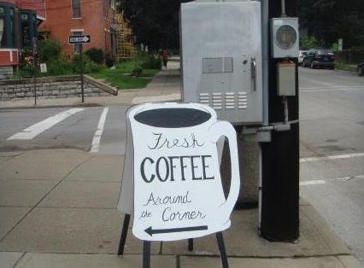
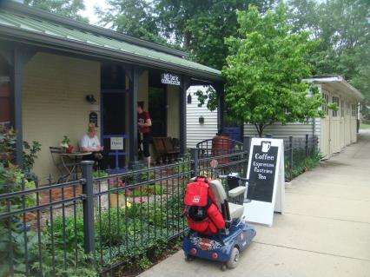
Business Creation
Key Component in HOPE VI Program
Can help determine impact of investment
New jobs and economic activity will help improve neighborhood
Influx of local businesses can help create a greater sense of community; encourages residents to spend money in their city
Crucial to attract the right kind of businesses

Slide 21
Business Creation Evaluation
Covington, Kentucky
Not a dramatic upswing of business development located in the Eastside neighborhood
Increase of businesses in 2014; no evidence of business development in 2015
Expect that business development will increase when River’s Edge at Eastside Pointe and the single-family homes are fully occupied
Anticipated increase of land and property values in the area
Multiplier effect for employment
HOPE VI will create 17 direct or indirect jobs per $1 million spent
At the very minimum, 323 jobs were created with HOPE VI funding of $19 million
Notes:
* Possibly due to incomplete data

Slide 22
Business Creation Evaluation
Covington, Kentucky
Since 2009, Covington experienced approximately $42 million in new or renovated housing
Created an estimated 731 jobs
Of these jobs, 82% will go to those with a high school diploma or less education
Half of these jobs will also go to minorities
As the population increases, the number of business in the area will increase.
Notes:
* Possibly due to incomplete data

Slide 23
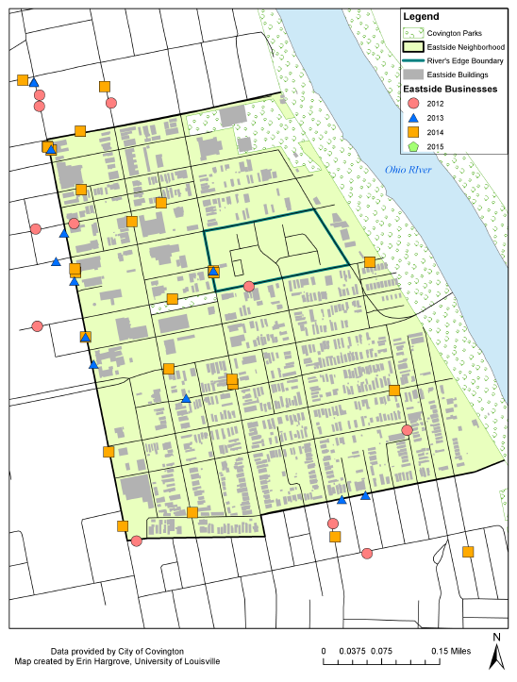
EASTSIDE BUSINESSES
Notes:
Development in the

Slide 24
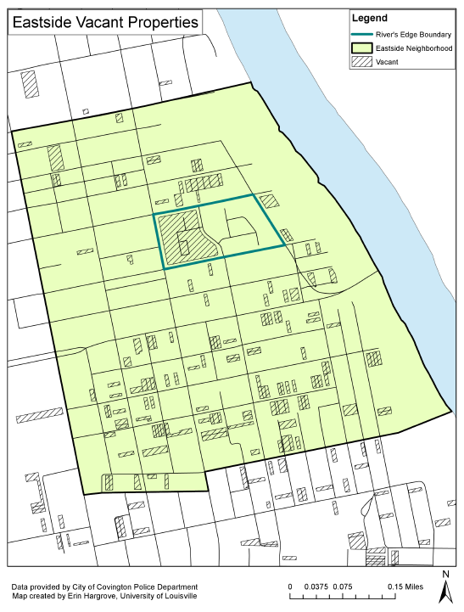
VACANT PROPERTIES

Slide 25
Crime
Crime reduction is proprietary goal for HOPE VI; HUD requires that crime is measured and reported
Analyzed yearly reports of crime in the City of Covington with particular focus on the Eastside neighborhood
Data limitations made it impossible to analyze data by neighborhood
Utilized proxy measure: calls for service, not perfect substitute

Slide 26
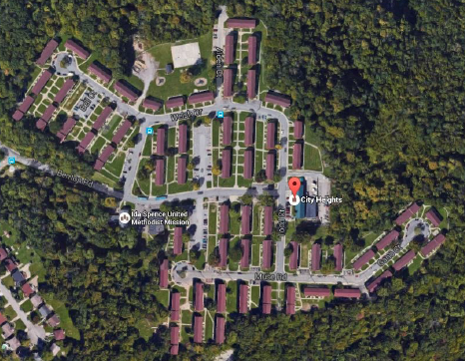
Housing Design and Crime City Heights

Slide 27
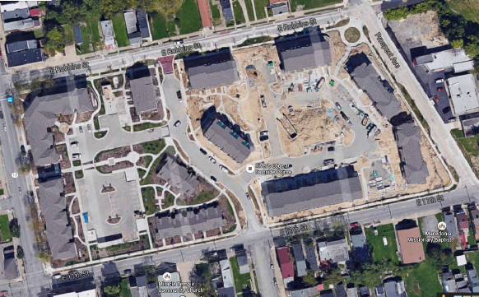
Housing Design and Crime River’s Edge at Eastside Pointe

Slide 28
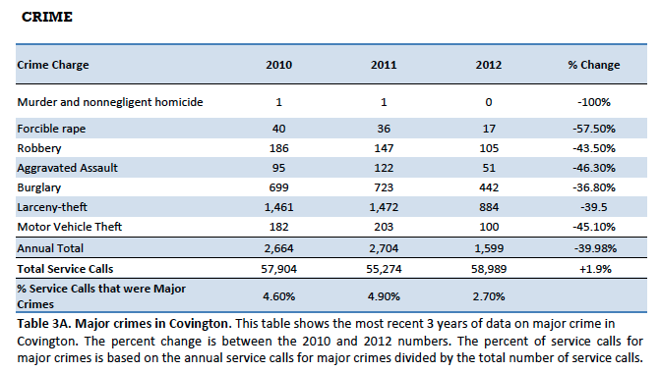
Major Crimes in the City of Covington

Slide 29
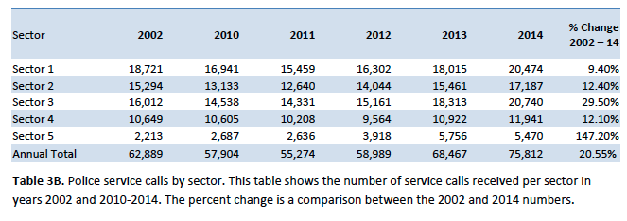
Number of Service Calls Per Police Sector

Slide 30
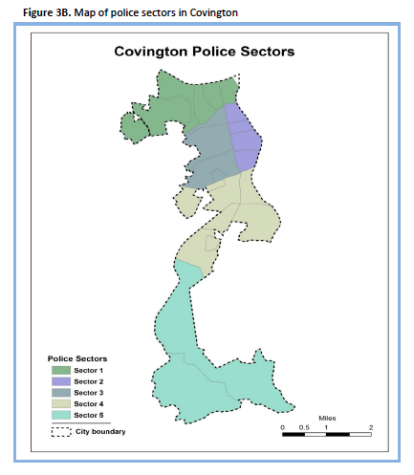

Slide 31
Service Call Statistics
Eastside Neighborhood
Ranked 4th for most service calls in 2013
Increased to 3rd in 2014
Remained in top five for service calls over the past five years
City of Covington
Service calls fluctuated since 2002
Highest number of service calls in the 13 years data was collected in 2014
Attributed to many factors including heroin trafficking and police response to any medical emergencies related to drug use

Slide 32
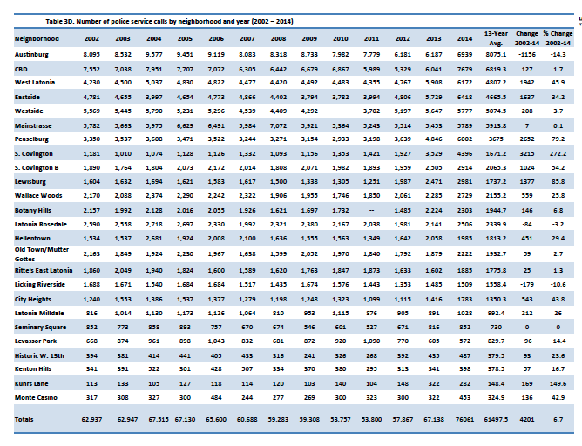
Service Calls by Neighborhood

Slide 33
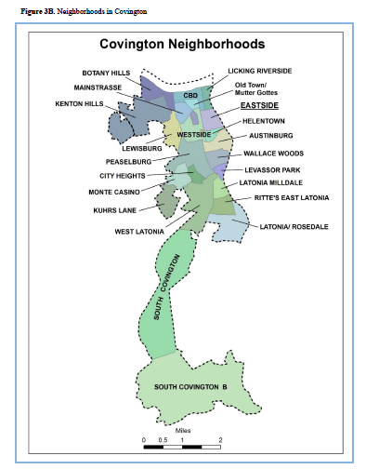

Slide 34
Social Services
Covington’s HOPE VI program has established an essential resident support structure through a number of community and social services
Goal is to improve the quality of life
Report summarizes how services have been utilized and how many residents used each service in the previous years

Slide 35
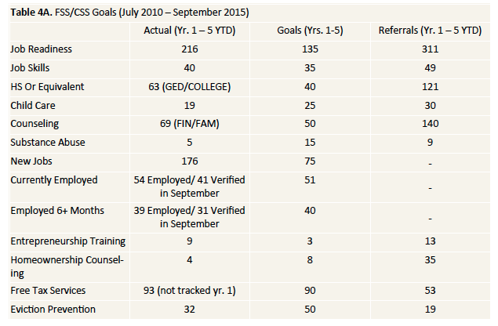
Social Services

Slide 36
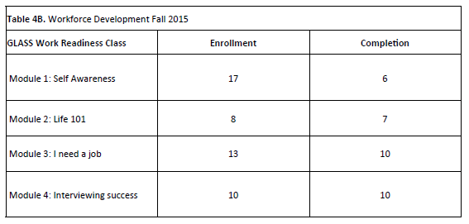

Slide 37
Family Self-Sufficiency Program
Encourages communities to develop local strategies to help public housing families obtain employment that will lead to economic independence and self sufficiency
Of the 15 self-sufficiency services listed, HAC surpassed nine of their 13 five-year goals for the HOPE VI program
HAC’s five-year goal for substance abuse, homeownership counseling, and eviction training were not productive
Child-care is the only self-sufficiency program that has declined below the five-year goal
Development is incomplete
Most children have “aged out”

Slide 38
Accomplishments
Family Self-Sufficient Program Accomplishments (3rd Quarter 2015)
18 are employed, 14 employed 6+ months (78%)
3 new job placements
7 are attending college/post-secondary education
1 made the Dean’s List
1 began GED study
3 received raised and benefits at work
2 moved to River’s Edge at Eastside Pointe
1 started Driver’s Education courses
2 pending FSS program graduations
12 established escrow accounts (48%)=
Balances total $36,846
4 actively accruing escrow every month

Slide 39
Design and Location Needs of HOPE VI

Slide 40
Introduction
River’s Edge at Eastside Pointe
One of the best green housing developments for low- and moderate- income in the country
Revitalized urbanist style community
38 buildings with a total of 120 housing units, 9 new homes, and 12 renovated historic homes
Extends beyond the green recommendations of Enterprise Green Communities and the USGBC’s LEED Silver Certification
Illustrates how peace, equality, health, and justice can be achieved through physical design

Slide 41
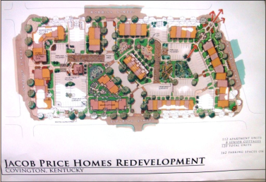
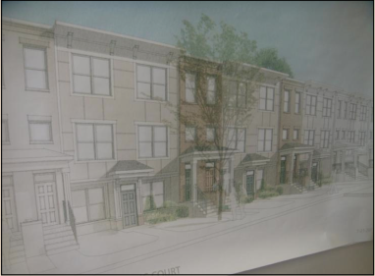
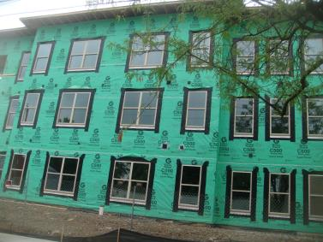
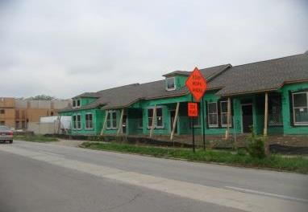

Slide 42
Improving LEED Guidelines
Emphasizing Nature over Mechanicals
LEED is not the be-all for environmental design
Provides extensive benefits in sustainability, health, equitability, and design
Missing elements of sustainable design:
Expanding the interplay between city policy and solar oriented development
Simple mechanics that reduce energy consumption as opposed to Energy Star products
Comprehensive effects of well-planned landscaping and scale
Minimal credit for recycling old building materials
Minimal credit for banning smoking

Slide 43
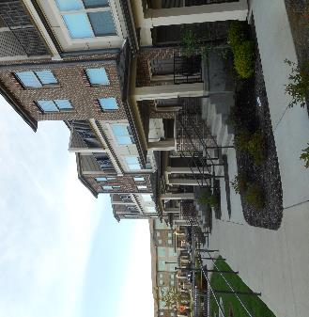
Sustainable Communities: The Ecological Impacts of Housing and Neighborhood Design
Nature versus High-tech engineering
Harnessing the Solar Resource
Landscaping: Creating a Healthy and Vibrant Community
Sustainable Drainage Systems

Slide 44
Recommendations
Environmentally preferred products
Rooftop gardens
Dog parks
Areas for improvement not addressed by LEED or Developers
Reflective surfaces
Permeable surfaces
Beautiful buildings are rarely demolished
Protected and artistic bike racks
Roof rainwater management
Tall ceilings
Three story face of the building lining the sidewalk/street
Traffic calming design
Protected bike lane

Slide 45
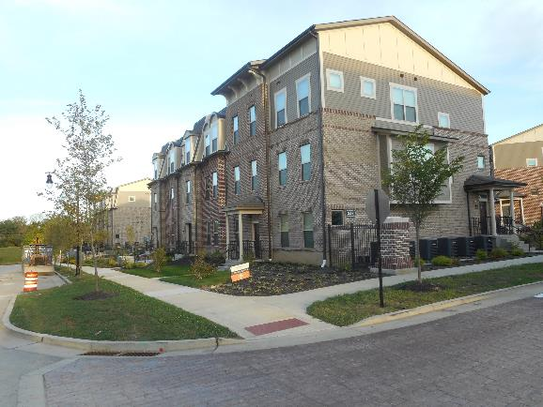
Sustainable Neighborhoods
Continuous sidewalks lining apartments with amenity areas
Buffer zones between sidewalks and the street (i.e. grass and trees)
Trees and other landscaping provides shade and visual interest
Sitting areas to encourage older residents to walk
Curb cuts for disabled
Complete Streets and Neighborhoods for All

Slide 46
Analysis of Job Creation

Slide 47
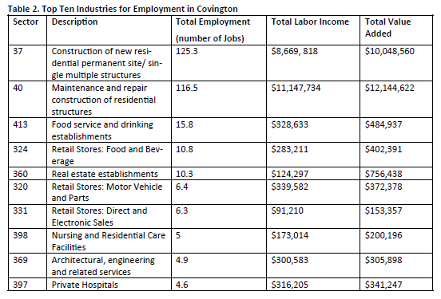

Slide 48
Conclusion
HOPE VI generates job opportunities in Covington and Newport
Covington: 731 jobs, resulting in a $42 million impact
Newport: 480 jobs
Creates twice the number of jobs than expanding a freeway or an industry like an automobile plant
Locate the development in a walkable neighborhood
Reduces car dependency for seniors and provides active transportation
Covington, Kentucky’s HOPE VI development is one of the best examples of an energy efficient and affordable mixed-income development
HOPE VI provides a compass for future affordable housing and community efforts

Slide 49
Survey of HOPE VI Residents

Slide 50
Survey Methodology: Measures
106-item survey
Nine sections:
Neighborhood Satisfaction (20 items)
Community and Safety (21 items)
Community Activity and Involvement (6 items)
Available and Affordable Housing (3 items)
Technology (6 items)
Education (7 items)
Health and Fitness (7 items)
Green Features (8 items)
Demographics (15 items)
Approximately 10-15 minutes to complete

Slide 51
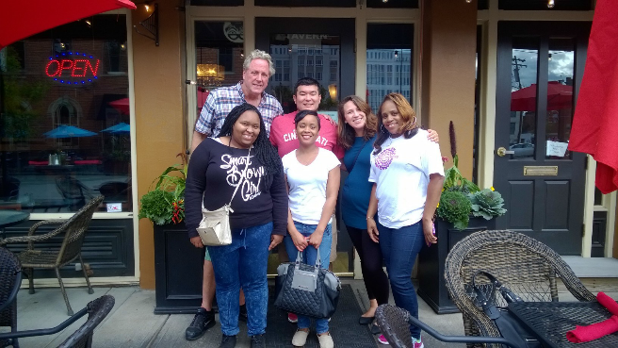
Survey Methodology
Data Collection
River’s Edge, City Heights, Golden Tower, Latonia Terrace, and scattered sites across Northern Kentucky and Cincinnati residents
Participants received $5 gift card to local grocery store if they completed survey
Optional drawings
Data Input
Statistical Processing for Social Sciences v. 23 (SPSS)
140 completed surveys were obtained overall
35 HOPE VI residents returned completed surveys
Data Analysis
Frequency and descriptives to examine basic nature of the data
Collapsed variables to bivariate variable “agree or disagree”
Independent t-tests
Differentiate HOPE VI residents and others
Differentiate HOPE VI residents, River’s Edge residents, and other respondents

Slide 52
Summary of HOPE VI Resident Surveys
Many felt satisfied with their neighborhood
Some concerns regarding safety using a bicycle in the neighborhood; overall, majority felt safe in their neighborhood
Most do attend events in the neighborhoods or in Covington, but are not a member of a community organization or group
HOPE VI residents felt that the houses were affordable and well-maintained
Two-thirds have access to computer and 80% can easily use one
Most reported they volunteer and are involved in after-school activities
Every resident has a primary health care provider
Like living in a place with diverse people
HOPE VI residents took more pride in their communities than others

Slide 53
River’s Edge at Eastside Pointe
City Heights
Sustainable housing development
Location is superior
Mixed-income community
No exposure to dangerous toxins and mold
Better access to healthy foods that are affordable
Lower crime
Traditional public housing
Location is several miles away from downtown Covington
Low-income residents only
Exposure to dangerous toxins and mold
No access to healthy, fresh foods that are affordable
Higher crime
Notes:
The location of River’s Edge at Eastside Pointe is superior, as it is positioned closer to downtown, has more frequent bus services, and is closer to jobs, medical, and educational opportunities. The problem of dangerous toxins and mold that exists in traditional public housing has been eliminated in River’s Edge at Eastside Pointe, although this could become a issue if the developer developer allows smoking

Slide 54
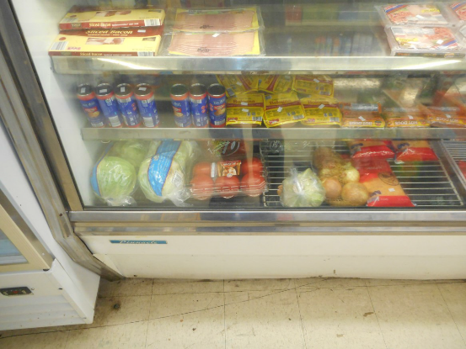
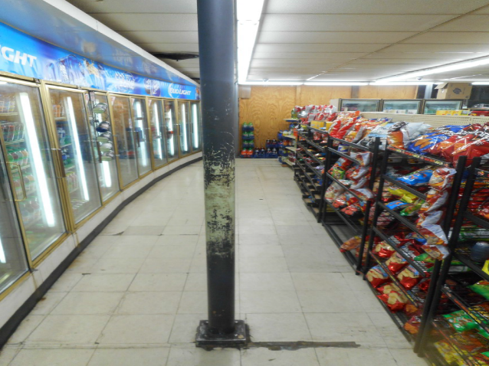
Survey Field Notes
Response to strangers in the community
Interviews conducted on the playground
Nobody likes or wants the convenience store at City Heights
They miss the community

Slide 55
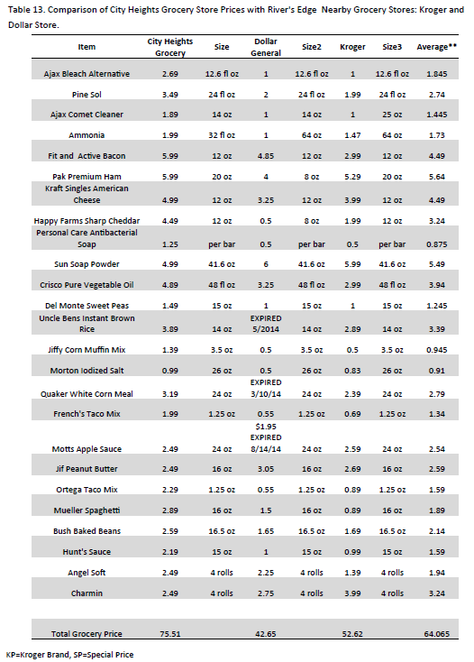

Slide 56
CONCLUSION
HOPE VI Residents Want to Live in Diverse Communities
Overall, HOPE VI Residents are Satisfied with Their Neighborhoods
Units Can be Built, but Communities Take Time

Slide 57
An Action Plan for Saving Covington Neighborhoods
Traffic Calming- Slower, not faster
Increase bike lanes
Historic Preservation
Encourage Walkability
Plant Trees and Community Gardens
Demand Qualified Bank Appraisers
Increase Homeownership
Good Architecture
Great Schools
Urban Art
Reduce Crime
Embrace Gentrification

Slide 58
ACKNOWLEDGEMENTS
Mayor Carran
Michael “Spike” Jones
Brian Carter
Aaron Wolfe-Bertling
Jeff Rieck
Chris Badburn
Linda DiGirolamo
Dr. Ellen Slaten
Nick York
Emmanuel Frimpong-Boamah
Erin Hargrove
Chad Frederick
Ra´Desha Williams
Dr. James Canfield
Jennifer Bennett

